Slide 1


JAIN INSTITUTE OF TECHNOLOGY DAVANGERE
Arka Educational & Cultural Trust (Regd.)
(A unit of Jain Group of Institutions, Bangalore)
DEPARTMENT OF COMPUTER SCIENCE AND ENGINEERING
Phase-2 Presentation-1:
on
“Heart Attack Prediction Using Machine Learning Algorithms”
Under the Guidance:
Mrs. Manjula P
Assistant Professor,
Dept of CS&E,JIT Davangere
Presented By :
Darshan M V
Hemanth E
Halaswamy M H
Aravind U R

Slide 2

CONTENTS
Introduction
Literature Survey
Objectives
Methodology
System Design
Implementation
Results

Slide 3

INTRODUCTION
Heart attack is the leading cause of death in the world over past 10years.
Several different symptoms are associated with heart attack which makes it difficult to diagnose it quicker and better.
This issue can be resolved by adopting machine learning techniques.

Slide 4
LITERATURE SURVEY
Author and Title | Methods used | Discussion
1.Mr.SanthanaKrishnan.J Title: Prediction of Heart Attack Using Machine Learning Algorithms | Naive Bayes Classifier Decision Tree | Naive Bayes Classifier(75% Accuracy)
2.Avinash Golande Title:Heart Attack Prediction Using Effective Machine Learning Techniques | Decision tree K – Nearest Neighbour | Decision tree (86.60% Accuracy)
3. V.V. Ramalingam Title: Heart Attack prediction using machine learning techniques | Naive Bayes Support Vector Machine K – Nearest Neighbour Decision Tree Random Forest | SVM has more accuracy than other techniques.

Slide 5
OBJECTIVES
The purpose of this project is to determine how well different types of Machine Learning Models perform for a given classification problem.
The system uses medical parameters such as age, sex, blood pressure, cholesterol, chest pain, diabetes, ECG, heart rate, etc for prediction.
The Effective Heart Attack Prediction System (EHPS) predicts the likelihood of patients getting heart attack or not.

Slide 6
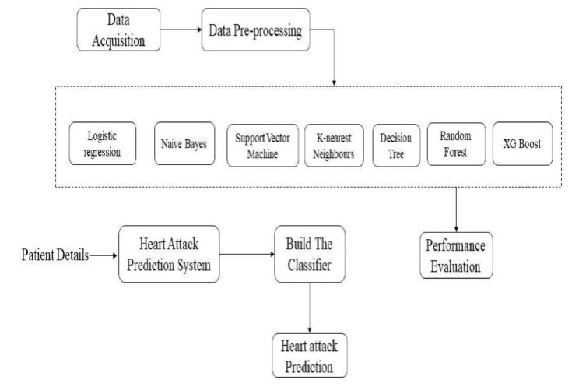
METHODOLOGY

Slide 7
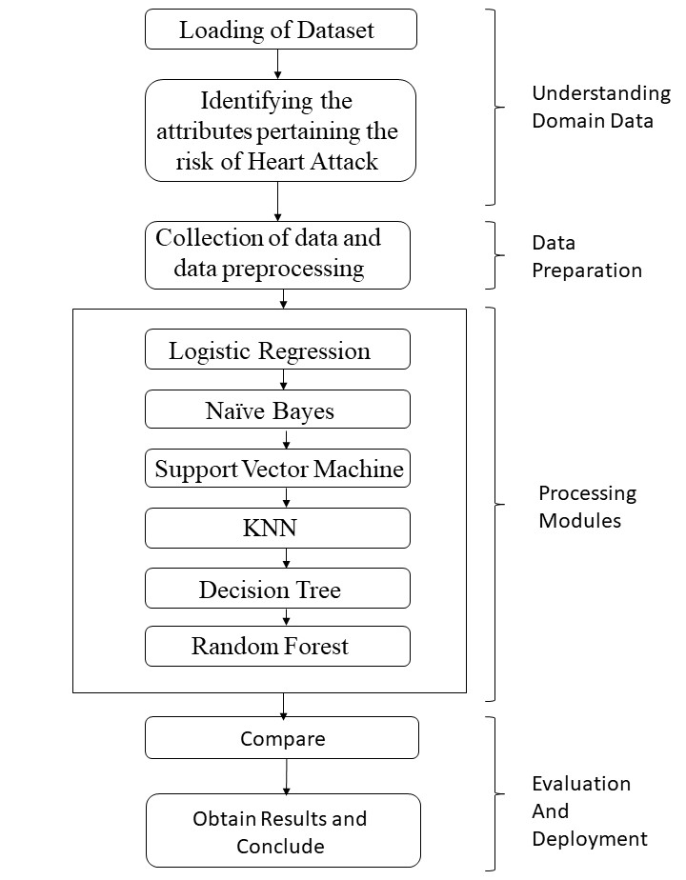
SYSTEM DESIGN
SYSTEM ARCHITECTURE

Slide 8
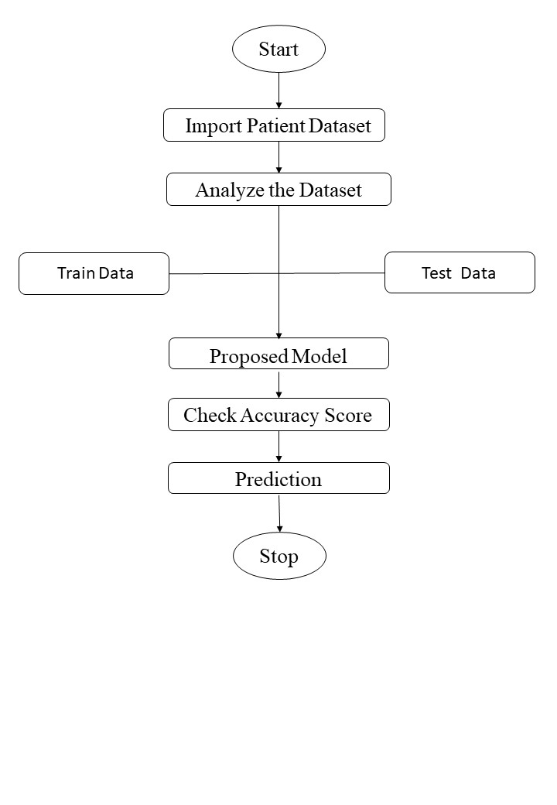
DATA FLOW MODEL

Slide 9
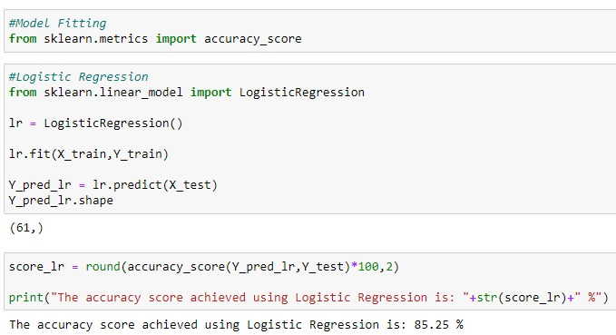
IMPLEMENTATION
Logistic Regression:
It is a supervised learning classification algorithm used to predict the probability of a target variable.

Slide 10
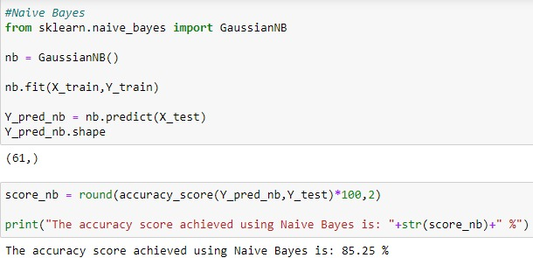
Naive Bayes:
Naive Bayes Classifier is one of the simple and most effective Classification algorithms which helps in building the fast machine learning models that can make quick predictions.

Slide 11
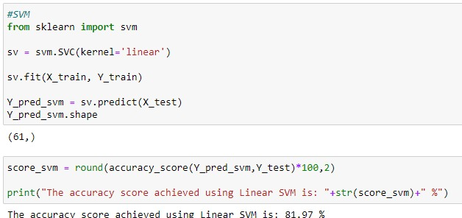
Support Vector Machine(SVM):
The objective of SVM algorithm is to find a hyperplane in an N-dimensional space that distinctly classifies the data points.

Slide 12
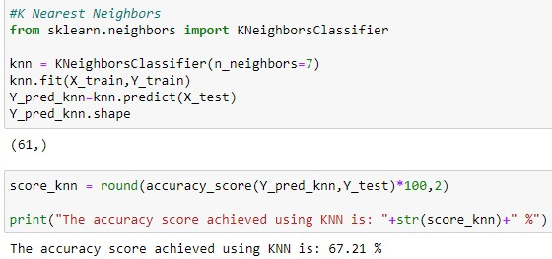
K Nearest Neighbour:
It is a supervised machine learning algorithm. The algorithm can be used to solve both classification and regression problem statements.

Slide 13
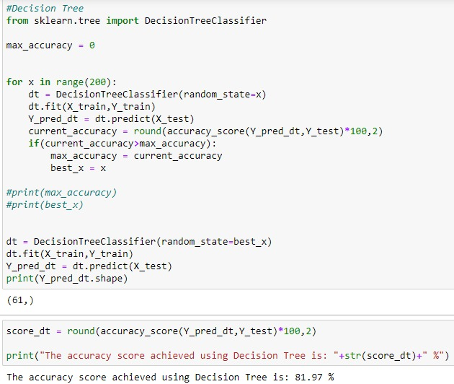
Decision Tree:
Decision Trees are a type of Supervised Machine Learning (that is you explain what the input is and what the corresponding output is in the training data) where the data is continuously split according to a certain parameter.

Slide 14
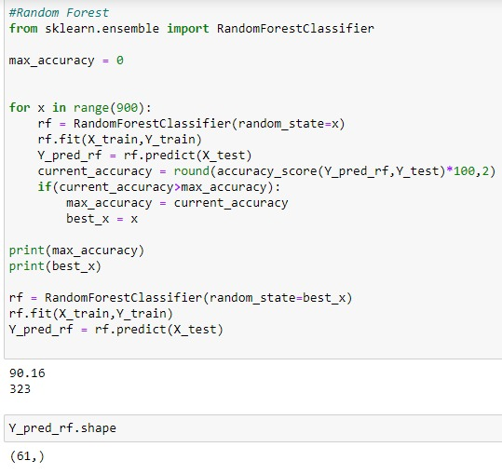
Random Forest:
Random Forest is a popular machine learning algorithm that belongs to the supervised learning technique. It is based on the concept of ensemble learning, which is a process of combining multiple classifiers to solve a complex problem and to improve the performance of the model.

Slide 15
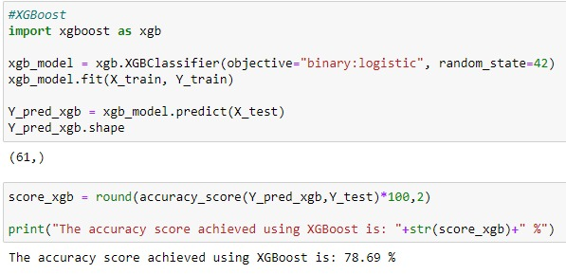
XGBoost Classifier:
XGBoost is an optimized distributed gradient boosting library designed to be highly efficient, flexible and portable. It provides a parallel tree boosting to solve many data science problems in a fast and accurate way.

Slide 16
Graphical User Interface:
-HTML
-CSS
The Hyper Text Markup Language is a standard markup language for documents designed to be displayed in a web browser.
CSS is the language used to style an HTML document.

Slide 17
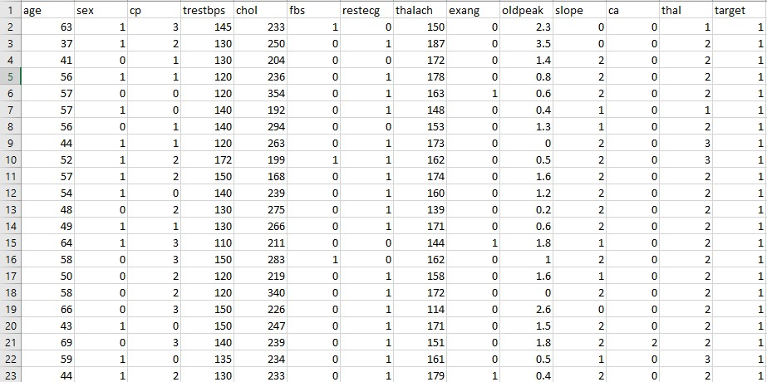
RESULTS
Dataset:

Slide 18
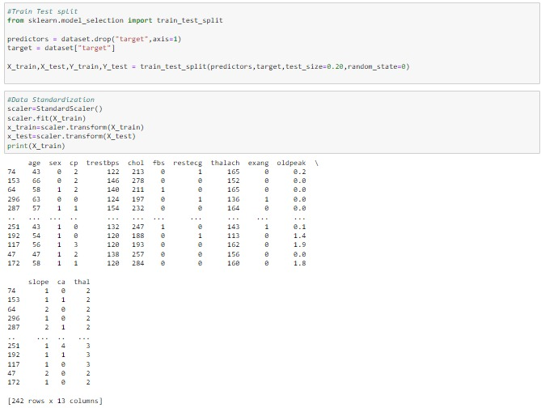
Data Preprocessing:

Slide 19
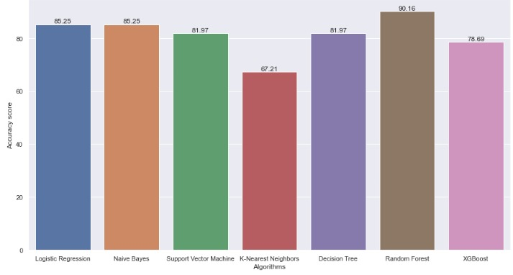
Accuracy Score:

Slide 20
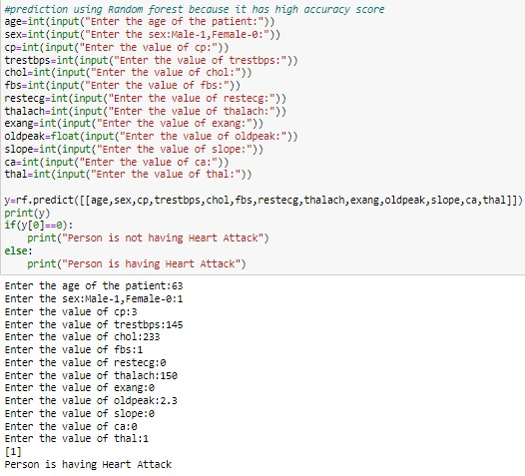
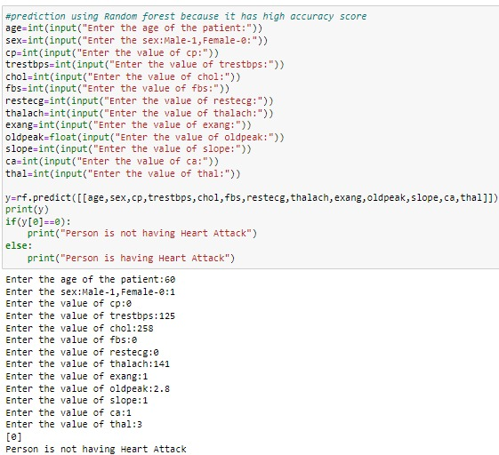
Prediction:
Having Heart Attack
Not Having Heart Attack

Slide 21

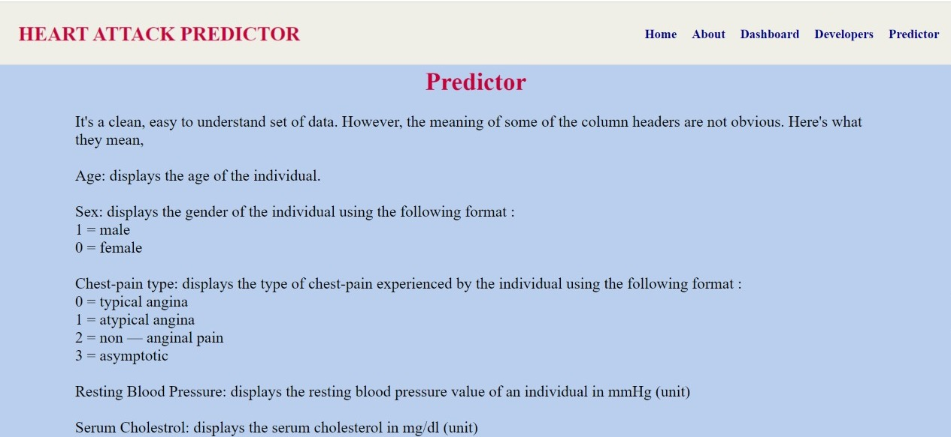
Screenshots of the interface:

Slide 22
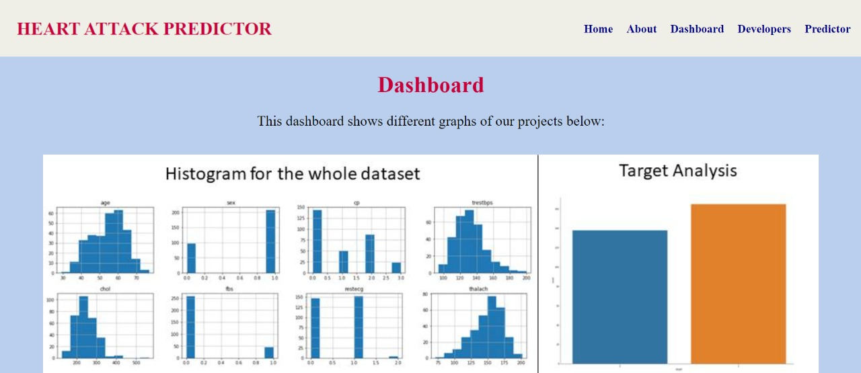
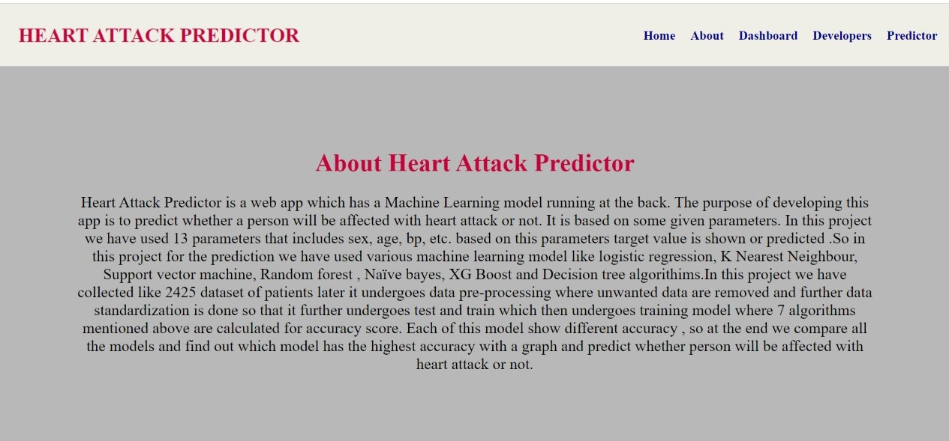

Slide 23
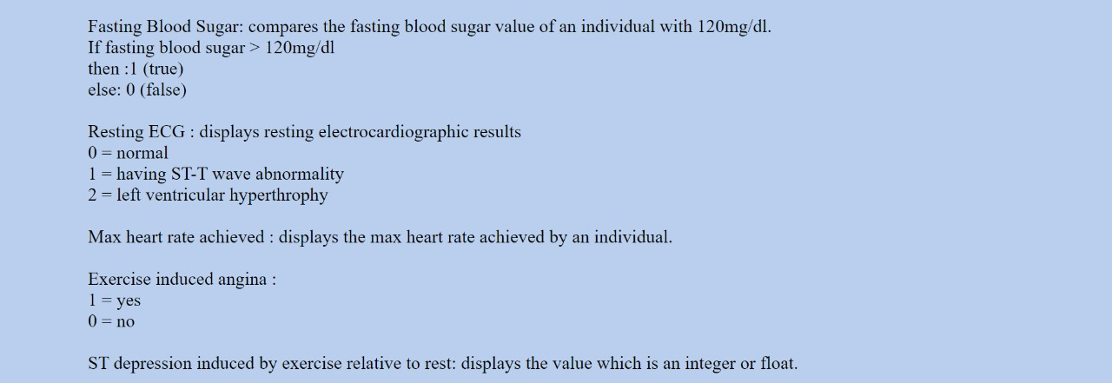
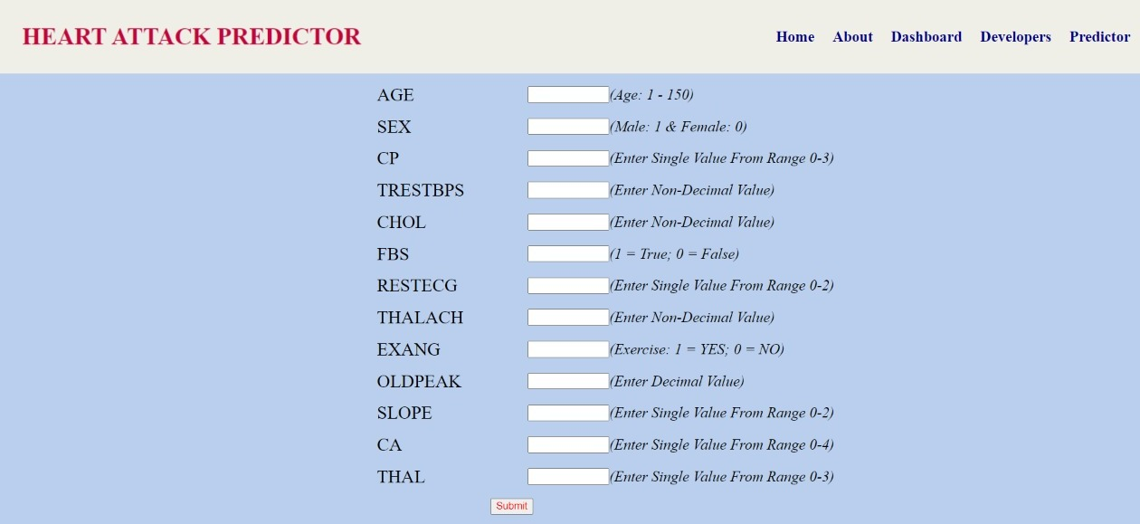

Slide 24
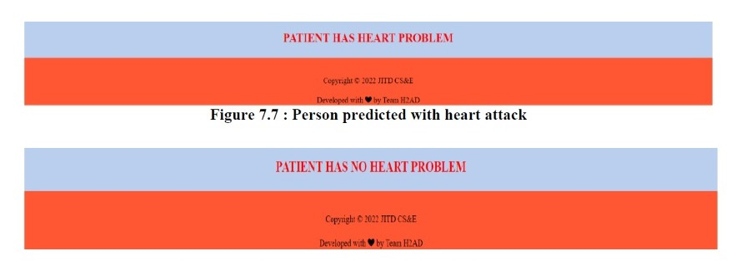

Slide 25
REFERENCE
[1] Mr.Santhana Krishnan.J, Dr.Geetha.S,” Prediction of Heart Disease Using Machine Learning Algorithms”,2019 1st International Conference on Innovations in Information and CommunicationTechnology(ICIICT),doi:10.1109/ICIICT1.2019.8741465.
[2] V.V. Ramalingam, Ayantan Dandapath, M Karthik Raja,” Heart disease prediction using machine learning techniques: a survey”, International Journal of Engineering & Technology, 7 (2.8) (2018) 684-687.
[3] Avinash Golande, Pavan Kumar T,” Heart Disease Prediction Using Effective Machine Learning Techniques”, International Journal of Recent Technology and Engineering (IJRTE) ISSN: 2277-3878,Volume-8, Issue-1S4, June 2019.

Slide 26
THANK YOU…!!!

